Slide 1

Energy system modelling using OSeMOSYS
LECTURE 5
ENERGY SUPPLY

Slide 2
Learning Outcomes
By the end of this lecture, you will be able to:
ILO1: Understand the general representation of technologies in OSeMOSYS
ILO2: Understand the technology parameters: Input Activity Ratio, Output Activity Ratio, and Capacity to Activity Unit
ILO3: Understand how technology costs are represented in OSeMOSYS
ILO4: Learn how to represent Primary Energy Supply technologies in OSeMOSYS
2

Slide 3

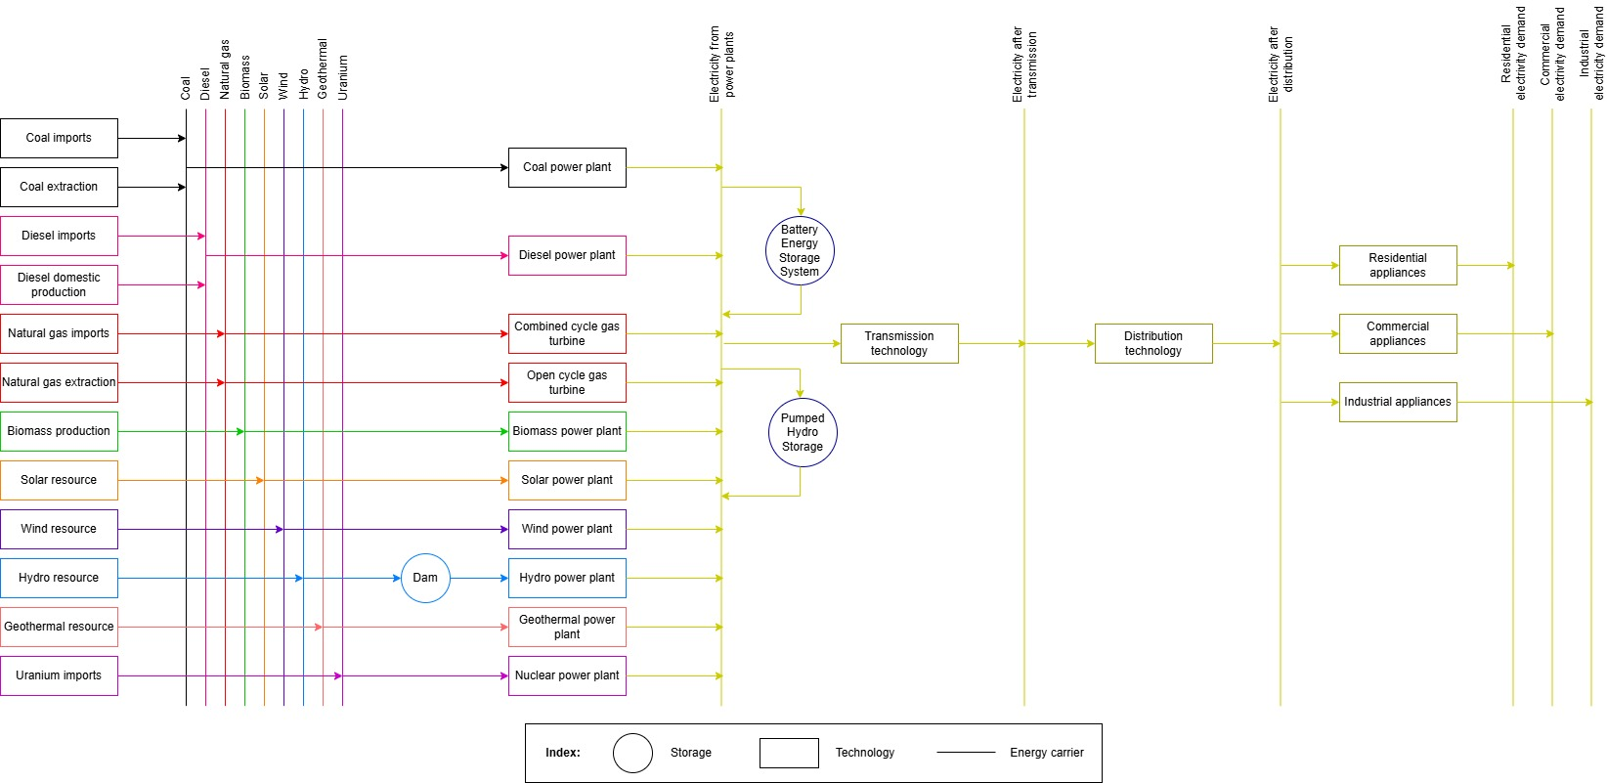
5.1 Technologies in OSeMOSYS
5.1.1 What are technologies in OSeMOSYS?
Each box = 1 technology
3
Notes:
A technology represents a process (or group of processes) that:
Supplies or produces a form of energy or energy service, for example oil imports or extraction, or a natural gas stove to supply cooking service
Converts one form of energy into another or into an energy service, for example conversion of crude oil to oil products, oil products to electricity or electricity to heat
Transfers, transmits or distributes a form of energy, for example electricity transmission technologies
As we have seen previously, each box in a Reference Energy System represents a technology.

Slide 4
5.1 Technologies in OSeMOSYS
5.1.2 Technology Examples
Natural gas
Natural gas extraction
Coal
Electricity
Coal power plant
Diesel
Electricity
Diesel power plant
Electricity 001
Electricity 002
Transmission technology
4
Notes:
This diagram shows some example technologies taken from the previous Reference Energy System diagram. Let’s look at how these technologies are represented:
The Natural Gas Extraction technology has an output fuel of natural gas, since this is what the technology produces. It has no input fuel as this is a primary energy supply technology found on the far left of our Reference Energy System. This will be covered in more detail later in this lecture.
The Coal Power Plant has an input fuel of coal and an output fuel of electricity, since this technology converts the energy in coal to electricity.
Similarly, the Diesel Power Plant converts the energy in diesel to electricity and so has an input fuel of diesel and an output fuel of electricity.
It is important to note that not all technologies have one input fuel and one output fuel. For example, fuel extraction technologies do not typically have an input fuel (just like the natural gas example on this diagram), and some technologies can have more than one input or output fuel, such as a refinery with crude oil as the input fuel, producing both gasoline and diesel as output fuels.

Slide 5
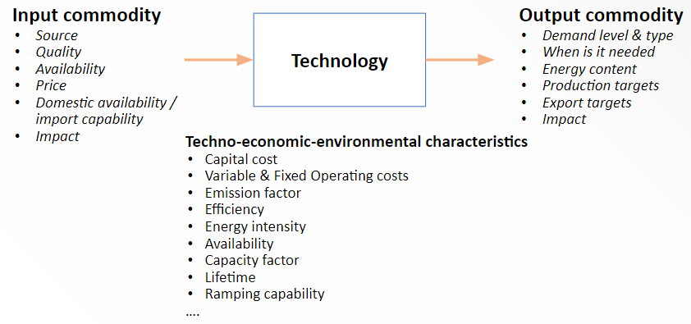
5.1 Technologies in OSeMOSYS
5.1.3 Parameters that Define Technologies
(Taliotis et al. (2018), image, licensed under CC BY 4.0)
5
Notes:
There are three main groups of data that are used to define technologies. These include the input commodity, which refers to the fuel supply to the technology. Important data on the input commodity include its price, availability and impacts. For example, the greenhouse gas emissions associated with using the fuel. Secondly, we need data on the techno-economic and environmental characteristics of technologies. These include technology costs, efficiency, lifetime and availability. Finally, we need to define each technology’s output commodity, which is the commodity it produces. Important data on output commodities include their demand, energy content and impacts.

Slide 6
5.1 Technologies in OSeMOSYS
5.1.4 Representing Technologies in OSeMOSYS
Represents all nuclear power plants
6
Notes:
Since models are abstractions of reality, we can define technologies at different levels of abstraction depending on the nature of our energy model. In OSeMOSYS, one technology can therefore represent different things, for example a technology could represent one single process or power plant e.g. a named coal power plant. A technology could also represent a group of processes or power plants with similar characteristics, for example one technology could be used to represent all existing coal power plants if no further detail is needed. In our examples and hands-on exercises, we will use this grouping approach, with one technology to represent all power plants of the same type. This is shown in this diagram and highlighted for nuclear power plants as an example. We will also aggregate transmission and distribution networks into single transmission and distribution technologies.

Slide 7
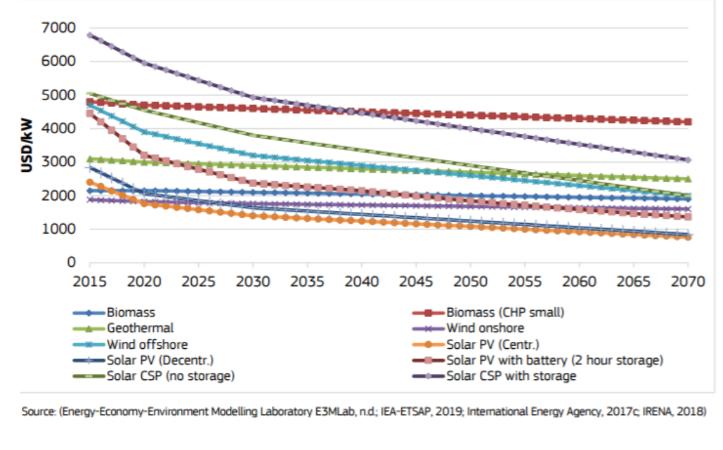
5.1 Technologies in OSeMOSYS
5.1.5 Considering Key Characteristics of Technologies
(Pappis et al. (2019), image licensed under CC BY 4.0)
7
Notes:
There are several important technology characteristics that should be considered in capacity expansion planning. Models developed using OSeMOSYS have the capability to consider several of these characteristics, including:
Variation in the availability, efficiency and costs of a technology over both short and long timescales. For example, new technologies that have high costs now may be expected to become significantly cheaper in the future. This diagram, which presents capital cost projections for renewable energy technologies, shows that some technology costs are expected to fall in the future. These technologies may therefore become more important for cost-effectiveness in the future, so it is important that OSeMOSYS can consider time-variable cost data.
Models can also consider limits on production by technology and capacity constraints. For example, there is a limit to how much power can be generated by solar PV in a given country based on the intensity of the sunlight over the year. It is important that OSeMOSYS can consider this so that its results are aligned with reality.
Additionally, we can consider the emissions associated with technologies and limits that may be placed on them. For example, we may want to develop a model scenario to understand how the Carbon Dioxide emissions associated with a country’s energy system can be reduced to a certain level, so it is important that OSeMOSYS can consider the emissions associated with each technology and has the capability to impose limits on them.

Slide 8
Lecture 5.1 References
Taliotis, Constantinos, Gardumi, Francesco, Shivakumar, Abhishek, Sridharan, Vignesh, Ramos, Eunice, Beltramo, Agnese, … Howells, Mark. (2018, December). Representing primary energy supply in OSeMOSYS. Zenodo. http://doi.org/10.5281/zenodo.4558799
Pappis, I., Howells, M., Sridharan, V., Usher, W., Shivakumar, A., Gardumi, F. and Ramos, E., Energy projections for African countries, Hidalgo Gonzalez, I., Medarac, H., Gonzalez Sanchez, M. and Kougias, I., editor(s), EUR 29904 EN, Publications Office of the European Union, Luxembourg, 2019, ISBN 978-92-76-12391-0, doi:10.2760/678700, JRC118432
8

Slide 9
5.2 Key Parameters in OSeMOSYS
5.2.1 Activity and Capacity
Activity refers to the amount of output produced by a technology in a given period, typically measured in energy service units (e.g., PJ, Mtons, passenger km). It represents how much a technology operates to meet demand and is central to calculating fuel use, emissions, and costs.
Activity
Capacity refers to the maximum output a technology can produce at any given time, usually measured in capacity units (e.g., GW, Mton/year, 1000 vehicles). It defines the installed size of a technology and limits the level of activity it can perform in each time slice.
Capacity
Notes:
Activity refers to the amount of output produced by a technology in a given time period, typically measured in energy service units (e.g., PJ, Mtons, vehicle km). It represents how much a technology operates to meet demand and is central to calculating fuel use, emissions, and costs.
Capacity refers to the maximum output a technology can produce at any given time, usually measured in capacity units (e.g., GW, Mton/year, thousand vehicles). It defines the installed size of a technology and limits the level of activity it can produce in each time slice.
In OSeMOSYS you can input data on activity and capacity to represent historical data or future real or hypothetical plans. The model additionally provides outputs on the activity and capacity of each technology annually, helping to support energy planning and investment strategies.

Slide 10
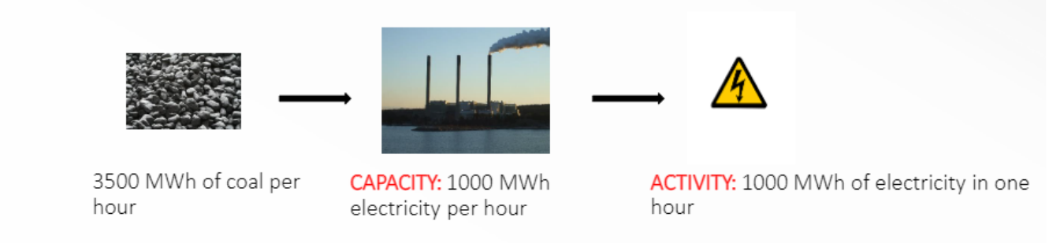
5.2 Key Parameters in OSeMOSYS
5.2.2 Capacity & Activity for Power Plants - Example
(Taliotis et al. (2018), image, licensed under CC BY 4.0; made using images from: D Harris, image, CC BY SA 2.0; Zygimantus, image, CC BY SA 4.0; Party Pop, image, CC BY-SA 3.0)
10
Notes:
Looking at our example of a coal power plant above, the diagram shows that the amount of coal that can be supplied to the power plant is 3500 MWh per hour, and using this coal the power plant can produce 1000MWh of electricity per hour. The capacity of our coal power plant is therefore 1000MWh of electricity per hour, and the activity would be 1000MWh of electricity in one hour, 2000MWh of electricity in 2 hours, and so on. Nevertheless, there are often limits on the capacity and activity of power plants. For example, the capacity of coal power plants may be limited by budget constraints or the activity may be limited by the amount of coal available.

Slide 11
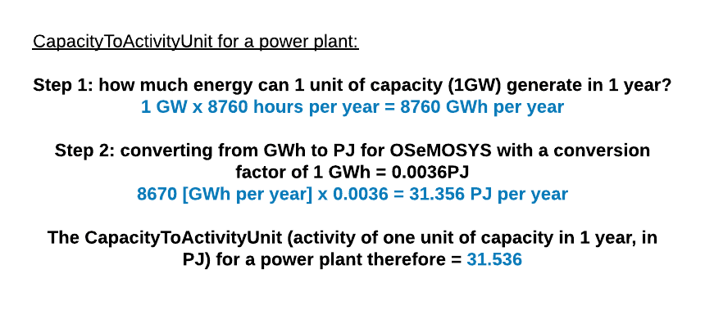
5.2 Key Parameters in OSeMOSYS
5.2.3 Capacity to Activity Unit
Capacity To Activity Unit
The maximum amount of activity that one unit of capacity can produce in a year.
Notes:
Capacity to activity unit is the maximum amount of activity 1 unit of capacity can produce in a year. For certain technologies the capacity to activity unit is set. For example, 1GW of capacity can only generate a maximum of 31.536 PJ of activity in a given year as shown in the equation above. Similarly, in industry for example if your capacity unit is Mt/year. Then you know that 1 unit of capacity will produce 1 Mt of activity in a year. The only case where things are a bit different is in the transport sector where you have a known activity (e.g. number of kilometre-metres travelled by cars) and a known capacity (e.g. total number of cars on the road) which means you would have to calculate the capacity to activity unit by dividing the activity by the capacity values.

Slide 12


5.2 Key Parameters in OSeMOSYS
5.2.4 Capacity Factor – Part 1
Capacity Factor (CF): Capacity available per each timeslice expressed as a fraction of the total installed capacity, with values ranging from 0 to 1.
$$Activity \left( production\right)=Capacity∗time∗CF$$
$$Installed Capacity=1 GW$$
$$Activity during one hour working at 100\%$$
$$=1 GW∗1h=1 GWh or 0.0036 PJ$$
$$Activity during one hour working at 20\% (CF=0.2)$$
$$=1 GW∗0.2∗1 h=0.2 GWh$$
$=$ 0.00072 PJ
Hydro power plant
Notes:
An important parameter in the relationship between capacity and activity is the capacity factor. In OSeMOSYS, the capacity factor is the ratio of actual output of a technology to its maximum possible output over a specific time period. It reflects how much a technology is actually used compared to its full potential, accounting for availability, downtime, or resource variability (like the variability of the sun, wind, and water flow). The energy produced (activity) varies based on the capacity factor, as shown in the example.

Slide 13

5.2 Key Parameters in OSeMOSYS
5.2.5 Capacity Factor – Part 2
If a hydroelectric plant has an installed capacity of 240 MW, what level of activity can it provide in one day in MWh assuming CF equal to 0.55?
$$1 day=24 hours$$
$$Activity \left(energy production\right)=Capacity∗time∗CF$$
$$Activity \left(energy production\right)=240 MW∗24 h∗0.55$$
$$Activity \left(energy production\right)=3168 MWh$$
13
Notes:
In this example, the first step is to calculate the number of hours in one day. Since one day equals 24 hours, we then calculate the energy produced by multiplying the installed capacity of 240 MW by the 24-hour period and the capacity factor of 0.55. This provides us with the amount of energy production the hydroelectric plant can produce in one day, which is 3,168 MWh. If the capacity factor was 1 instead of 0.55 (the plant was able to run constantly throughout the day) then the energy production would be much higher at 5, 760 MWh. However, in reality there might not be a lot of water flow at a particular time of the day or there might be other constraints which result in the plant only being use for a little over half its full potential, resulting in a lower level of possible activity.

Slide 14
5.2 Key Parameters in OSeMOSYS
5.2.6 Activity Ratios
Input Activity Ratio
Output Activity Ratio
Used to specify how much of an input is needed to support the Activity of a Technology. It specifies how many units of input are needed for each unit of activity.
Used to specify how much output is generated from the Activity of a Technology. It specifies how many units of output are produced for each unit of activity.
Notes:
The InputActivityRatio is used to specify how much of an input is needed to support the Activity of a Technology. It specifies how many units of input are needed for each unit of activity.
As an example, consider a natural gas fired power station with a conversion efficiency of 50%. The input to the plant is natural gas and the Activity represents electricity generated. This means that for every unit of electricity generated, 2 units (1/50%) of natural gas are needed. Consequently, the InputActivityRatio should be set to 2 in this case. This parameter is time dependent and can vary from year to year.
The InputActivityRatio is specified for each technology/commodity combination. If a technology has 2 or more input commodities, then that technology would have a InputActivityRatio for each commodity that is needed.
The OutputActivityRatio is used to specify how much output is generated from the Activity of a Technology. It specifies how many units of output are produced for each unit of activity. This parameter is time dependent and can vary from year to year.
As an example, consider maize cultivation. The Activity of the maize cultivation could represent how much land is planted with maize (measured in hectares), while the output would be the number of tonnes of maize produced. If 1,000 hectares of maize cultivation yields 4,500 tonnes, then the ratio of output to activity is 4.5 (4,500/1,000). Consequently, the OutputActivityRatio should be set to 4.5 tonnes per hectare in this case.
The OutputActivityRatio is specified for each technology/commodity combination. If a technology has 2 or more output commodities, then it would have an OutputActivityRatio for each commodity.
It is important to note however, that typically if the input activity ratio has a specific value then the output activity ratio is 1 and vice versa. This helps normalize the activity and define it for 1 unit (e.g. how much input is needed for 1 unit of output or vice versa) making it easier to scale. For example, if you know that you need 1.389 PJ of biomass to produce 1 PJ of heat in a biomass heater then the input activity ratio is 1.389 and the output activity ratio is 1. This is typically how it is represented in the OSeMOSYS model.
Technologies can also have multiple input activity ratios and multiple output activity ratios as mentioned above. For example, industry plants typically need both electricity and heat to produce their product. Therefore, if you know 1.263 PJ of electricity and 6.113 PJ of heat are needed to produce 1 Mton of steel. Then your input activity ratio for electricity will be 1.263 and for heat will be 6.113 and your output activity ratio for steel will be 1. Another important example to note is the transmission technology input and output activity ratios. Transmission and distributions represent the transport of electricity and sometimes fuels from power plants to end-users. Transmission and distribution systems are never 100% efficient and there are typically always losses. This could be from heat losses, illegal wire tapping etc. Therefore, the output of the transmission technology is typically less than the input, so we model this by giving the technology an output activity ratio of 1 and an input activity ratio of 1.02 if it experiences 2% losses (1/0.98=1.02) or 1.042 if it experiences 4% losses (1/0.96=1.042) and so on. These examples are not exhaustive.

Slide 15
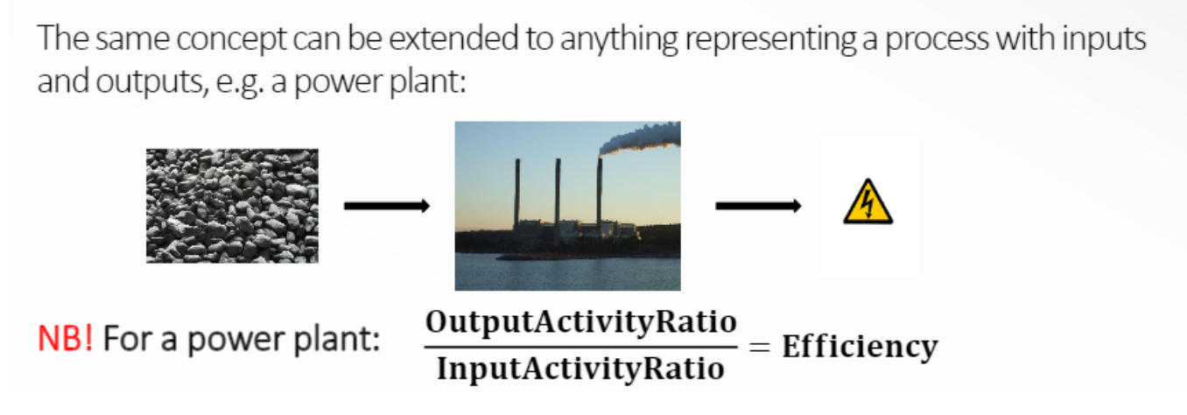
5.2 Key Parameters in OSeMOSYS
5.2.7 Representing Efficiency in OSeMOSYS – Part 1
Notes:
Although not applicable always (e.g. when modelling crops and land) – typically the relationship between the input and output activity ratios gives you the efficiency of a technology.
For example, a coal-fired power plant takes the input fuel of coal and produces the output fuel of electricity. It is important to remember that the efficiency of a power plant is equal to the Output Activity Ratio divided by the Input Activity Ratio. In OSeMOSYS it is typical to set the Output Activity Ratio to 1 and adjust the Input Activity Ratio accordingly. If the Output Activity Ratio is 1, the efficiency of a power plant is therefore equal to 1 divided by the Input Activity Ratio. One might argue that you could also set the Input Activity Ratio to 1 instead and then adjust the Output Activity Ratio to get the same efficiency. This would be correct from a fuel use point of view but it would destroy the capacity outputs of the model and the economics of that technology since the capacity of a technology in OSeMOSYS is typically determined based on the output activity ratio being set to 1.

Slide 16
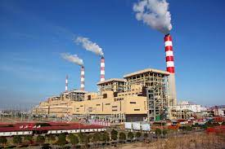
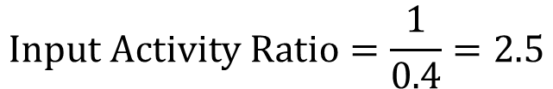
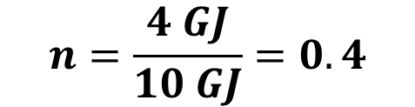
5.2 Key Parameters in OSeMOSYS
5.2.8 Representing Efficiency in OSeMOSYS – Part 2
Let’s look at a coal power plant as an example. If the amount of electricity produced is 25 GJ, how much coal in GJ was utilized?
4 GJ of electricity
$$n=\frac{4 GJ}{10 GJ}=0.4$$
10 GJ of coal
Coal power plant
$$Input Activity Ratio=\frac{1}{0.4}=2.5$$
$$2.5 GJ of coal produce 1 GJ of electricity$$
$$25 GJ of electricity∗\frac{2.5 GJ of coal}{1 GJ of electricity}=62.5 GJ of coal$$
16
Notes:
In this example, we have data indicating that a coal power plant produces 4 GJ of electricity using 10 GJ of coal. To calculate the plant’s efficiency, we divide the output energy by the input energy, yielding a value of 0.4 or 40%. The input activity ratio is then computed as the inverse of the efficiency, which is 1 divided by 0.4, equaling 2.5. The output activity ratio remains 1.
This means that 2.5 GJ of coal is required to produce 1 GJ of electricity. To calculate the coal needed to produce 25 GJ of electricity, we use the input/output activity ratio, resulting in 62.5 GJ of coal.

Slide 17
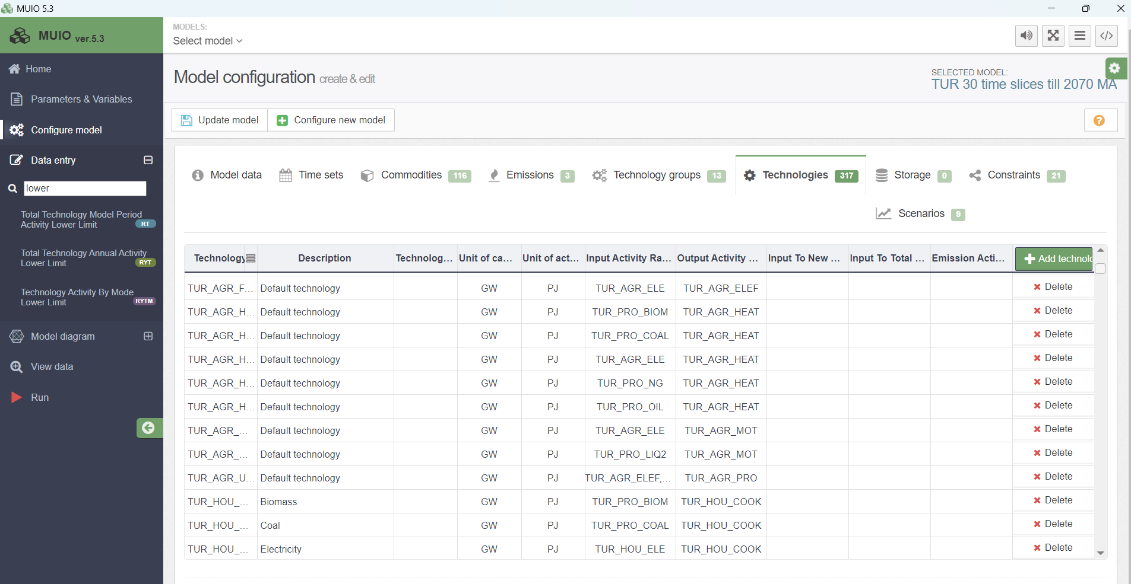
5.2 Key Parameters in OSeMOSYS
5.2.9 Input & Output Activity on MUIO
Notes:
The input and outputs of technologies are set up in the configuration page of the OSeMOSYS interface (MUIO) under the technologies tab. The commodities you select in the Input Activity Ratio column are the commodities going into your technology (commodities the technology needs to function) and the commodities you select in the Output Activity Ratio column are the commodities going out of the technology (produced by the technology).

Slide 18
Lecture 5.2 References
Taliotis, Constantinos, Gardumi, Francesco, Shivakumar, Abhishek, Sridharan, Vignesh, Ramos, Eunice, Beltramo, Agnese, … Howells, Mark. (2018, December). Representing primary energy supply in OSeMOSYS. Zenodo. http://doi.org/10.5281/zenodo.4558799
18
18

Slide 19
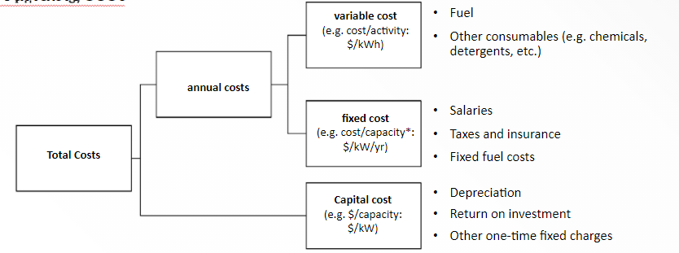
5.3 Costs
5.3.1 Introducing Technology Costs in OSeMOSYS
In OSeMOSYS, costs are split into Capital Costs, Fixed Costs, and Variable Costs
(Taliotis et al. (2018), image, licensed under CC BY 4.0)
19
Notes:
As well as defining the performance of a technology, it is important to define its costs. Technologies can require initial investments, as well as have costs that occur annually. In OSeMOSYS technology costs are split into 3 categories: variable costs (occurring annually), fixed costs (occurring annually) and capital costs (initial costs of the technology). This diagram shows the units of each of these costs and some examples of what they represent - we will look at each cost in more detail in the following slides.
Another potential cost that isn’t mentioned above is emission costs. This isn’t typically applied unless a user wants to apply a cost penalty for each unit of emissions produced in the model.

Slide 20
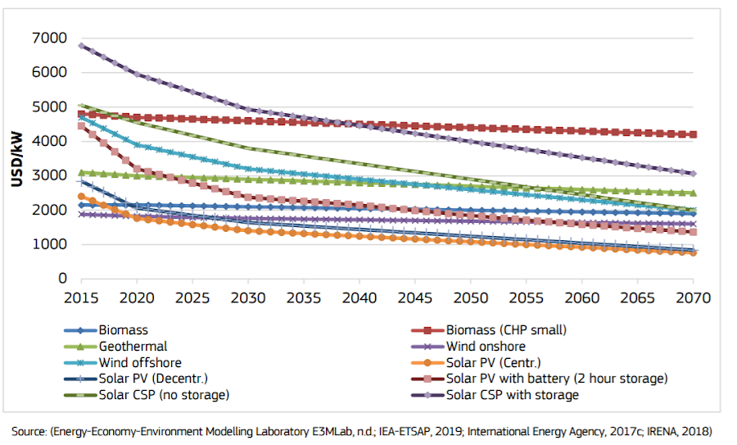
5.3 Costs
5.3.2 Capital Costs
(Pappis et al. (2019), image licensed under CC BY 4.0)
20
Notes:
The Capital Cost represents the initial cost of buying the technology and is defined as a function of technology capacity, using the unit $/kW. This includes the costs of the initial investments for the technology up until the point where it can start running. For example, the capital cost for a power plant would typically include the costs of planning and design; parts, machinery and building; construction; and commissioning and certification. Capital costs for some technologies, for example renewable technologies like solar PV, are likely to change in the future as shown in this diagram, and so the capital cost is defined for each model year in OSeMOSYS.

Slide 21
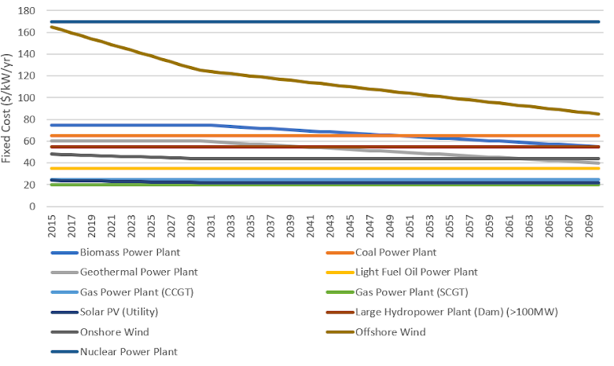
5.3 Costs
5.3.3 Fixed Costs
(Created using data from Pappis et al. (2019), report licensed under CC BY 4.0)
21
Notes:
The Fixed Cost is an annual cost defined as a function of technology capacity per year, using the unit $/kW/yr. This includes regular costs associated with the technology every year. For example, the fixed cost for a power plant would typically include the costs of paying workers’ salaries; regular operations and maintenance; taxes and insurance. As for capital costs, fixed costs for some technologies may be expected to change in the future, and so the fixed cost is also defined for each model year in OSeMOSYS. This diagram shows the fixed costs for different power plant types used in the TEMBA energy modelling study for Africa.

Slide 22
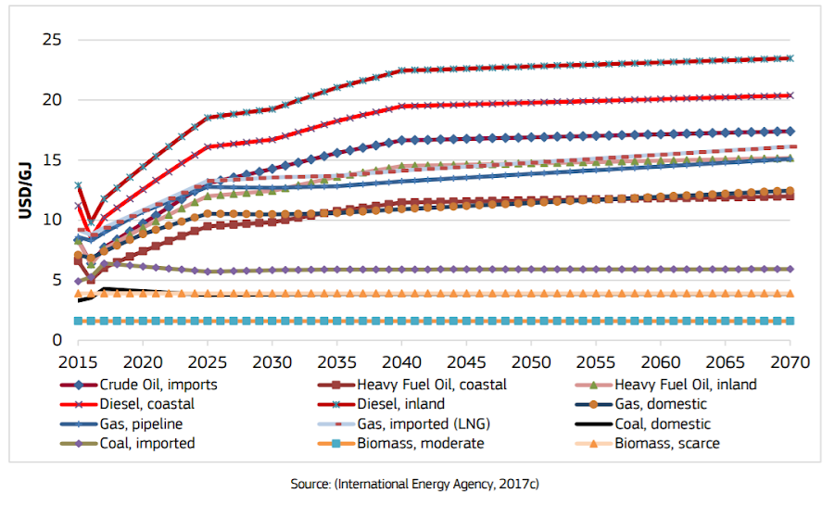
5.3 Costs
5.3.3 Variable Costs
(Pappis et al. (2019), image licensed under CC BY 4.0)
22
Notes:
The Variable Cost is defined as a function of technology activity, using the unit $/GJ. This includes the costs only associated with the technology’s activity, namely costs only incurred when a technology produces its output fuel/commodity. For example, the variable cost for a power plant is largely the cost of the power plant’s input fuel, as well as the costs of any other consumables like chemicals that are needed for the power plant to operate. This means that wind, solar PV and hydropower technologies often have variable costs of 0 as they do not require any fuels. As we will see in the next part of this lecture, the variable cost for primary energy supply technologies is the price of the commodity/fuel being supplied. For example, a Coal Imports technology would have a variable cost equal to the price of imported coal in each year. This diagram shows example fuel cost projections, which could be used for the variable costs for primary energy supply technologies. As we can see in the diagram, variable costs, especially fuel prices, may also change over time and so are defined for each model year in OSeMOSYS.

Slide 23
Lecture 5.3 References
Taliotis, Constantinos, Gardumi, Francesco, Shivakumar, Abhishek, Sridharan, Vignesh, Ramos, Eunice, Beltramo, Agnese, … Howells, Mark. (2018, December). Representing primary energy supply in OSeMOSYS. Zenodo. http://doi.org/10.5281/zenodo.4558799
Pappis, I., Howells, M., Sridharan, V., Usher, W., Shivakumar, A., Gardumi, F. and Ramos, E., Energy projections for African countries, Hidalgo Gonzalez, I., Medarac, H., Gonzalez Sanchez, M. and Kougias, I., editor(s), EUR 29904 EN, Publications Office of the European Union, Luxembourg, 2019, ISBN 978-92-76-12391-0, doi:10.2760/678700, JRC118432
23

Slide 24
5.4 Primary Energy Supply Technologies
5.4.1 Introducing Primary energy Supply Technologies
24
Notes:
Primary energy supply technologies typically represent one of two processes:
The domestic extraction or production of fuels, for example domestic coal production.
Importation of fuels, for example coal imports.
Fuels can include: coal, oil, oil products (such as diesel), natural gas, uranium, biomass, and more. By convention, for each fuel considered we typically include one import technology and one domestic production technology, as shown in this diagram. However, sometimes we may want to adjust this. For example if we are modelling for a country with no domestic coal reserves, we could simply exclude the domestic coal production technology. Or we may want to include two versions of a technology to represent different options. For example we could have separate technologies for importing natural gas via pipeline and via Liquefied Natural Gas transport, since these have different costs.

Slide 25
5.4 Primary Energy Supply Technologies
5.4.2 Primary Energy Supply Technologies in Reference Energy Systems
Coal
Coal imports (IMPCOA)
Coal
Coal extraction (MINCOA)
Diesel
Diesel imports (IMPDSL)
Diesel
Diesel domestic production (MINDSL)
25
Notes:
As shown in this diagram, Primary Energy Supply Technologies are typically represented in Reference Energy Systems by a technology (box) with only output fuels/commodities (lines) and no input fuel/commodities. For example, the coal extraction technology has no input fuel and produces coal as its output fuel. Usually positioned furthest left on Reference Energy System diagrams, we can think of primary energy supply technologies as the first step in the energy system; they produce the fuels used by other technologies to provide energy services and meet the demands usually found on the far right of Reference Energy System diagrams. As a reminder of our generic naming convention, primary energy supply technologies typically have a 6-letter name with the first segment being M.I.N for domestic fuel extraction or production technologies or I.M.P for import technologies, and the second segment being the code for the commodity/fuel being produced. Examples can be seen on this diagram.

Slide 26
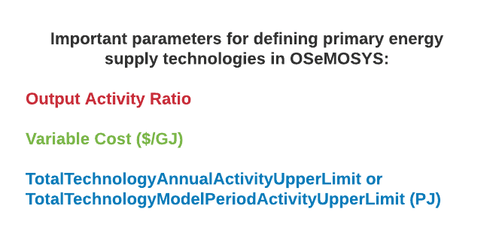
5.4 Primary Energy Supply Technologies
5.4.3 Primary Energy Supply Technologies in OSeMOSYS
26
Notes:
In OSeMOSYS, primary energy supply technologies are typically characterized by these key parameters:
Output Activity Ratio: as explained earlier, this defines which fuel the technology provides and at what rate.
Variable Cost [dollars per gigajoule]: this represents the costs of extraction or importation of the fuel.
Total Technology Annual Activity Upper Limit or Total Technology Model Period Activity Upper Limit [petajoules]: these are the parameters that can be used to define the level of proven reserves available for extraction or the maximum quantity that can be imported.

Slide 27
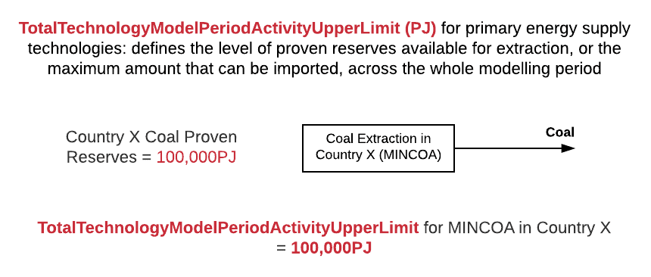
5.4 Primary Energy Supply Technologies
5.4.4 Total Technology Model Period Activity Upper Limit
27
Notes:
For primary energy supply technologies, the Total Technology Model Period Activity Upper Limit parameter can be used to define the level of proven reserves of the fuel that can be extracted or the maximum quantity that can be imported, across the whole modelling period. For example, if we were creating a model for Country X with a modelling period of 2015-2070, the Total Technology Model Period Activity Upper Limit for the domestic coal extraction technology (M.I.N.C.O.A.), would be the level of proven reserves available for extraction in country X from 2015-2070 as shown in this diagram.

Slide 28
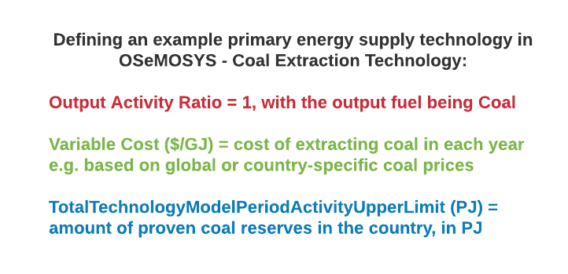
5.4 Primary Energy Supply Technologies
5.4.5 Summing Up with an Example
28
Notes:
To summarize, let’s think about how we would define an example primary energy supply technology, a coal extraction technology, in OSeMOSYS using the parameters we have covered in today’s lecture. First, we need to define the output activity ratio. The coal extraction technology produces coal as its output fuel and the output activity ratio is set to 1 by convention, so the output activity ratio will be 1 for the fuel coal. Then, let’s define the cost of the coal extraction technology. We do this by setting its variable cost equal to the cost of extracting coal in dollars per gigajoule for each year in the model period. Finally, we need to think about any limits that apply to this technology. If we know the amount of proven coal reserves in the country, we can include this in the model using the parameter Total Technology Model Period Activity Upper Limit, defined in petajoules. We will practice using data like this in a real OSeMOSYS model in the hands-on exercises.

Slide 29
Lecture 5.4 References
Taliotis,Constantinos, Gardumi, Francesco, Shivakumar, Abhishek, Sridharan, Vignesh, Ramos, Eunice, Beltramo, Agnese, … Howells, Mark. (2018, December). Representing primary energy supply in OSeMOSYS. Zenodo. http://doi.org/10.5281/zenodo.4558799
29

Slide 30
Thank you
Consolidated by:
Fernando Plazas-Niño, Trevor Barnes, Leigh Martindale
www.climatecompatiblegrowth.com

